Slide 1
Name : Khimsuriya Satya V. Roll No. : 91900957041
ESIT Presentation

Slide 2
HTML Programs
HTML Program -1 Code
<html>
<body style="background-color:hotpink; color: brown">
<h1>Program 1: Headings Tags</h1>
<h2>Name: Satya Khimsuriya</h2>
<h3>Department: ICT</h3>
<h4>Stream: DIPLOMA</h4>
<h5>Semester: 1</h5>
<h6>Welcome to my Heading Example</h6>
</body>
</html>

Slide 3
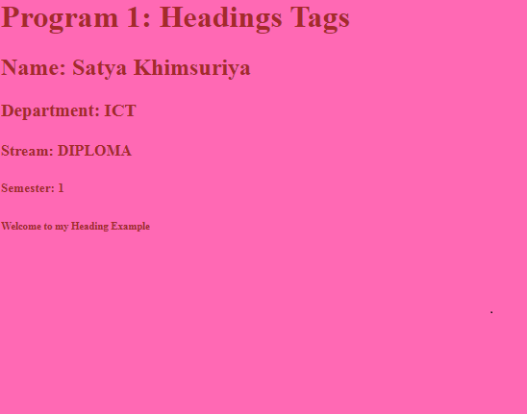
HTML Program-1 Out Put

Slide 4
HTML Program -2 Code
<html>
<body bgcolor="RED" style="color:YELLOW">
<h1>Program 2: Paragraph Tags</h1>
<h2>Name: Satya Khimsuriya</h2>
<p align="justify">This is my paragraph 1 in Program 2.</p>
<p align="center">This is my paragraph 2 in Program 2.</p>
<p align="right">Enrollment No: 91900957041</p>
<p align="right">Semester: 1</p>
<p align="right">Class: DK1</p>
<p align="right">Course: Diploma</p>
<p align="right">Department: ICT</p> </body>
</html>

Slide 5
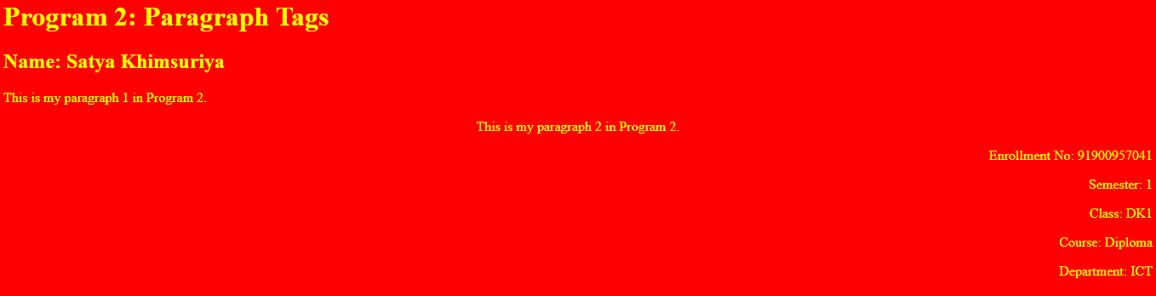
HTML Program-2 Out Put

Slide 6
HTML Program -3 Code
<html>
<body bgcolor="darkgreen">
<h1>Program 3: Text Formatting Tags</h1>
<h2>Name: Satya Khimsuriya</h2>
<p><b>My Enrollment no is: 91900957041</b></p>
<p><strong>Semester: 1</strong></p>
<p><big>Class: DK1</big></p>
<p><em>Diploma Engineering</em></p>
<p><i>Information and Communication Technology</i></p>
<p>This is<sub> subscript</sub> and <sup>superscript</sup></p>
<p><strike>This text is striked</strike></p>
</body>
</html>

Slide 7
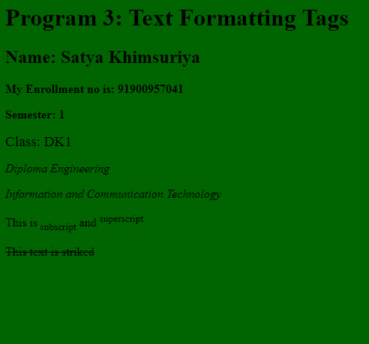
HTML Program-3 Out Put

Slide 8
<BODY> <TABLE BORDER=”3” BGCOLOR=”DARKYELLOW”> <h1>Program 4: Table</h1> <TR> <TH>NAME</TH> <TD BGCOLOR=”#C0C0C0”>KHIMSURIYA SATYA V.</TD> </TR> <TR> <TH BGCOLOR=”#C0C0C0”>ROLL.NO.</TH> <TD>91900957041</TD> </TR> <TR> <TH>GR. NO.</TH> <TD BGCOLOR=”#C0C0C0>107701</TD> </TR> <TR> <TH BGCOLOR=”#C0C0C0>PHONE NO.</TH> <TD>997 8574 214</TD> </TR> </TABLE> </BODY>
HTML Program -4 Code

Slide 9
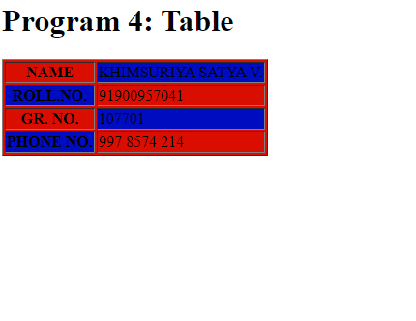
HTML Program-4 Out Put

Slide 10
Header Code <html> <body bgcolor="YELLOW" style="color:RED"> <h2>ESIT ONLINE LAB MANUAL <br/> Name: Satya Khimsuriya<br/> My Enrollment no is: 91900957041<br/> ICT-Diploma Engineering <br/> Semester: 1 Class: DK1 </h2> </body> </html>
HTML Program -4WebSiteCode

Slide 11
MainFrame Code <html> <frameset rows="25%,75%"> <frame src="Header.html"/> <frameset cols="25%,75%"> <frame src="Navigation.html"/> <frame src="" name="showframe"/> </frameset> </frameset> </html>

Slide 12
Navigation Code <html> <body> <h1> ESIT LAB INDEX</h1> <a href="A.html" target="showframe"/>Program 1: Headings Tags</a> <br/> <a href="B.html" target="showframe"/>Program 2: Paragraph Tags</a> <br/> <a href="C.html" target="showframe"/>Program 3: Text Formatting Tags</a> <br/> <a href="D.html" target="showframe"/>Program 4: Table</a> <br/> <a href="E.html" target="showframe"/>Program 5: Comment</a> <br/> <a href="F.html" target="showframe"/>Program 6: Preserve Formatting</a> <br/>

Slide 13
<a href="G.html" target="showframe"/>Program 7: Ref Link</a> <br/> <a href="H.html" target="showframe"/>Program 8: Image</a> <br/> <a href="I.html" target="showframe"/>Program 9: Unordered List:1</a> <br/> <a href="J.html" target="showframe"/>Program 10: Unordered List:2</a> <br/> <a href="K.html" target="showframe"/>Program 11: Ordered List</a> <br/> <a href="L.html" target="showframe"/>Program 12: Nested List</a> <br/> <a href="M.html" target="showframe"/>Program 13: Definition List</a> <br/> <a href="N.html" target="showframe"/>Program 14: Table Header</a> <br/> <a href="O.html" target="showframe"/>Program 15: Col&Row Span:1</a> <br/>

Slide 14
<a href="P.html" target="showframe"/>Program 16: Col&Row Span:2</a> <br/> <a href="Q.html" target="showframe"/>Program 17: Frame Horizontal</a> <br/> <a href="R.html" target="showframe"/>Program 18: Frame Vertical</a> <br/> <a href="S.html" target="showframe"/>Program 19: Frame Nested</a> <br/> <a href="T.html" target="showframe"/>Program 20: Frame Target</a> <br/> <a href="U.html" target="showframe"/>Program 21: Inline CSS</a> <br/> <a href="V.html" target="showframe"/>Program 22: Embedded CSS</a> <br/> <a href="W.html" target="showframe"/>Program 23: Form</a> <br/> </body> </html>

Slide 15
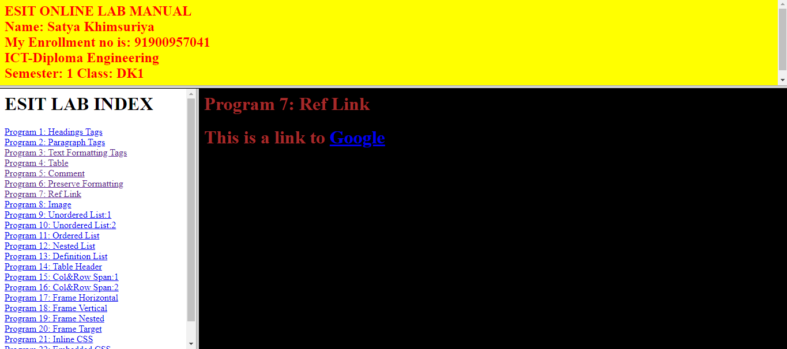
HTML Program-WebSite Out Put

Slide 16
CSS Programs
CSSProgram -1 Code
<html>
<head>
<style>
body{
background-color:skyblue;
}
h1{
color:red;
text-align:left;
}
</style>
</head>
<body>
<h1>My First HTML File</h1>
<p>My First Paragraph.</p>
</body>
</html>

Slide 17

CSS Program-1 Out Put

Slide 18
CSSProgram -2 Code
<html>
<head>
<style>
body{
background-color:skyblue;
}
h1,h3,h5{
color:red;
text-align:left;
text-align:center;
}
h2,h4,h6{
text-align:left;
text-align:center;
</style>
</head>
<body>
<h1>This is heading 1</h1> <h4>This is heading 4</h4>
<h2>This is heading 2</h2> <h5>This is heading 5</h5>
<h3>This is heading 3</h3> <h6>This is heading 6</h6>
</body>
</html>

Slide 19
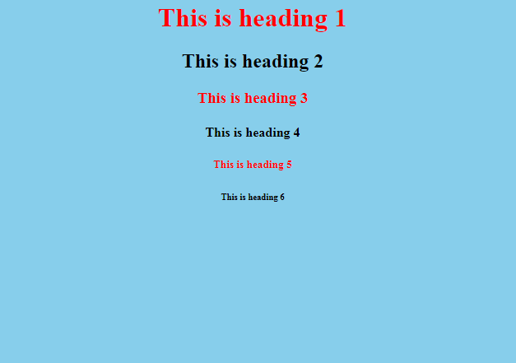
CSS Program-2 Out Put

Slide 20
CSSProgram -3 Code
<html>
<head>
<style>
body{
background-color:skyblue;
}
p{
font-family:verdana;
font-size: 20px;
text-align:center;
}
</style>
</head>
<body>
<p><b>This text is bold</b></p>
<p><strong>This text is strong</strong></p>
<p><big>This text is big</big></p>
<p><em>This text is emphasized</em></p>
<p><i>This text is italic</i></p>
<p>This is<sub> subscript</sub> and <sup>superscript</sup></p>
<p><strike>This text is striked</strike></p>
</body>
</html>

Slide 21
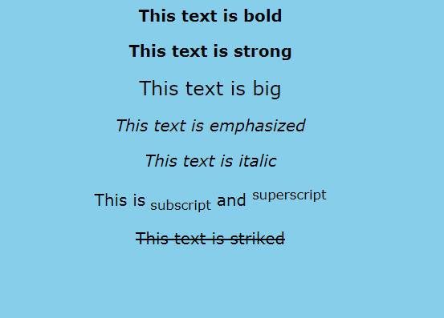
CSS Program-3 Out Put

Slide 22
CSSProgram -4 Code
<!DOCTYPE html>
<html>
<head>
<link rel="stylesheet" type="text/css" href="style.css">
<style>
table {
font-family: arial, sans-serif;
border-collapse: collapse;
width: 50%;
}
#t1 {
border: 2px solid #2db7f5;
text-align: center;
padding: 10px;
}
#t2 {
background-color: grey;
color: #fff;
}
</style>
<title>LAB 05</title>
</head>
<body>

Slide 23
<h3>THIS TABLE IS STYLED USING EXTERNAL CSS</h3>
<table>
<tr>
<th>A</th>
<th>B</th>
<th>C</th>
<th>D</th>
</tr>
<tr>
<td colspan="2">E</td>
<th rowspan="2">F</th>
<td>G</td>
</tr>
<tr>
<td>H</td>
<td>I</td>
<td>J</td>
</tr>
<tr>
<td>K</td>
<td>L</td>
<td>M</td>
<td>N</td>
</tr>
</table>
<br>
<br>

Slide 24
<h3>THIS TABLE IS STYLED USING INTERNAL CSS</h3>
<table class="c1">
<tr id="t2">
<th id="t1">A</th>
<th id="t1" colspan="2">E</th>
<th id="t1" rowspan="4">I</th>
</tr>
<tr id="t2">
<td id="t1">B</td>
<th id="t1" rowspan="2">F</th>
<th id="t1" rowspan="2">G</th>
</tr>
<tr id="t2">
<td id="t1">C</td>
</tr>
<tr id="t2">
<td id="t1">D</td>
<th id="t1" colspan="2">H</th>
</tr>
</table>
<br>
<br>

Slide 25
<h3>THIS TABLE IS STYLED USING INLINE CSS</h3>
<table>
<tr>
<th>A</th>
<th colspan="2">B</th>
<th style="background-color: green" rowspan="2">C</th>
<th colspan="2">D</th>
<th rowspan="2">E</th>
</tr>
<tr>
<td>F</td>
<th colspan="2">G</th>
<th>H</th>
<th style="background-color: pink" rowspan="2">I</th>
</tr>
<tr>
<td style="background-color: lightpink" rowspan="2">J</td>
<td>K</td>
<th rowspan="3">L</th>
<th>M</th>
<th>N</th>
<th>O</th>

Slide 26
</tr>
<tr>
<td>P</td>
<th colspan="2">Q</th>
<th>R</th>
<th style="background-color: black" rowspan="2">S</th>
</tr>
<tr>
<td style="background-color: silver" colspan="2">T</td>
<td style="background-color: red" rowspan="2">U</td>
<td colspan="2">V</td>
</tr>
<tr>
<td>W</td>
<td>X</td>
<td>Y</td>
<td style="background-color: gold" colspan="3">Z</td>
</tr>
</table>
</body>
</html>

Slide 27
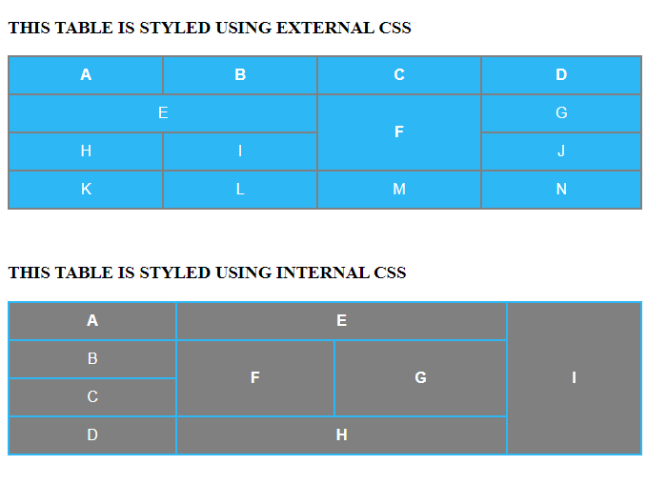
CSS Program-4 Out Put

Slide 28
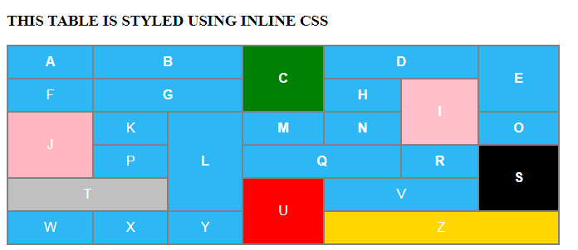

Slide 29
JS Programs
JS Program -1 Code
<!DOCTYPE html>
<html>
<body>
<h2>Welcome To JavaScript</h2>
<h3>JavaScript Code In Onclick Attribute</h3>
<form>
<input type="button" value="Click Me"
onclick="alert('hello ICT Sem-1')"/>
</form>
</body>
</html>

Slide 30
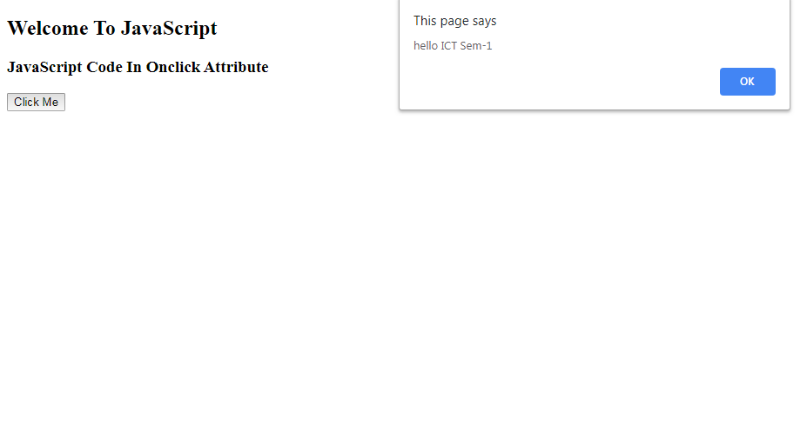
JS Program-1 Out Put

Slide 31
JS Program -2 Code
<!DOCTYPE html>
<html>
<head>
<script type="text/javascript">
function msg(){
alert('hello ICT Sem-1');
}
</script>
</head>
<body>
<h2>Welcome To JavaScript</h2>
<h3>JavaScript Code In Script in Head Section</h3>
<form>
<input type="button" value="Click Me"
onclick="msg()"/>
</form>
</body>
</html>

Slide 32
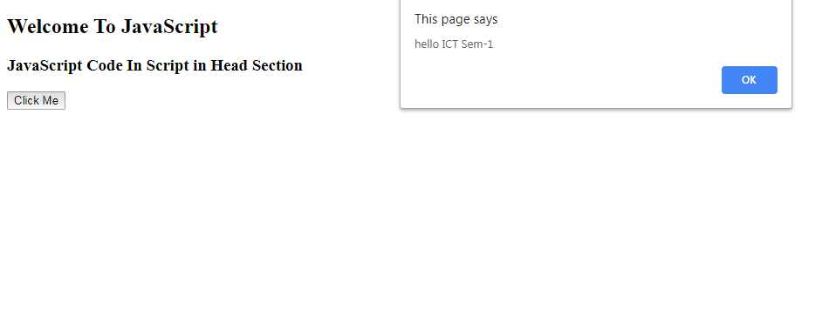
JS Program-2 Out Put

Slide 33
JS Program -3 Code
<!DOCTYPE html>
<html>
<head>
<script type="text/javascript">
function msg(){
alert('hello ICT Sem-1');
}
</script>
</head>
<body>
<h2>Welcome To JavaScript</h2>
<h3>JavaScrip <!DOCTYPE html>
<html>
<head>
<script type="text/javascript" src="msg.html">
</script>
</head>

Slide 34
<body>
<h2>Welcome To JavaScript</h2>
<h3>JavaScript Code In External JS File</h3>
<form>
<input type="button" value="Click Me"
onclick="msg()"/>
</form>
</body>
</html> t Code In Script in Head Section</h3>
<form>
<input type="button" value="Click Me"
onclick="msg()"/>
</form>
</body>
</html>

Slide 35
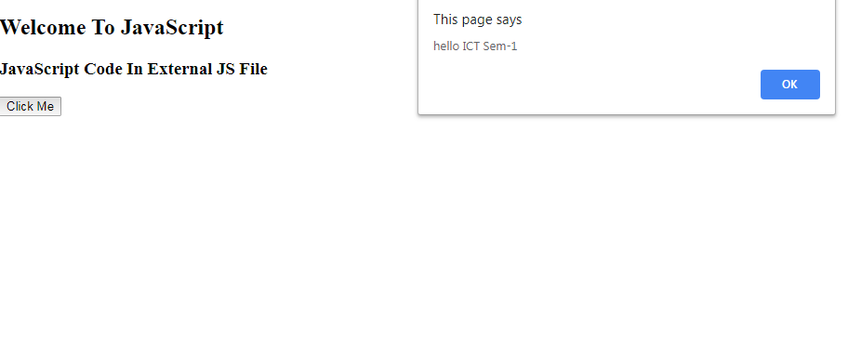
JS Program-3 Out Put

Slide 36
JS Program -4 Code
<!DOCTYPE html>
<html>
<head>
<script type="text/javascript">
function msg(){
alert('hello ICT Sem-1');
}
</script>
</head>
<body>
<h2>Welcome To JavaScript</h2>
<h3>JavaScrip <!DOCTYPE html>
<html>
<head> <!DOCTYPE html>
<html>
<body>
<h2>JavaScript Variable</h2>
<p id="demo"></p>
<script>
var x = "John" + "" + "Doe";
document.getElementById("demo").innerHTML = x;
</script>

Slide 37
<p>The Result Of Adding 2+3+"5":</p>
<p id="demo2"></p>
<script>
var x = 2 + 3 + "5";
document.getElementById("demo2").innerHTML = x;
</script>
<p id="demo3"></p>
<script>
var x = 5+5;
var y = "5"+5;
var z = "hello"+5;
document.getElementById("demo3").innerHTML = x + "<br>" + y + "<br>" + z;
</script>
</body>
</html>
<script type="text/javascript" src="msg.html">
</script>
</head>

Slide 38
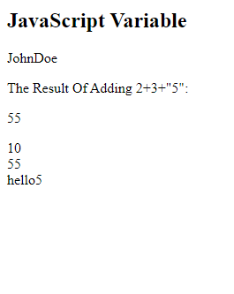
JS Program-4 Out Put

Slide 39
JS Program -5 Code
<html>
<head>
<script>
function n_value()
{
var n;
n_value= Number(document.getElementById("n_value").value);
if(n_value>100)
{
window.alert("Please Enter Right value");
}
else if(n_value>70)
{
window.alert("Distinction");
}
else if(n_value>60)
{
window.alert("Firstclass");
}

Slide 40
else if(n_value>50)
{
window.alert("Secondclass");
}
else if(n_value>35)
{
window.alert("pass");
}
else
{
window.alert("fail");
}
}
</script>
</head>
<body>
<br>
Enter n_value: <input type="text" id="n_value"></input><br/><br/>
<center><button onclick="n_value()">check n_value</button>
</body>
</html>

Slide 41
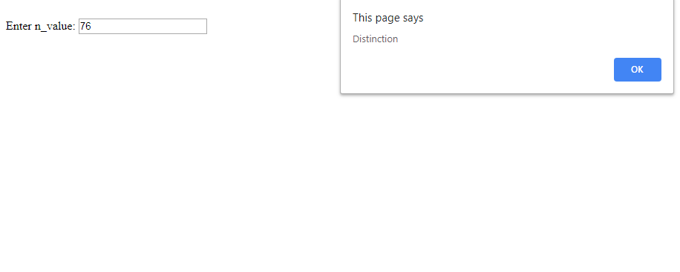
JS Program-5 Out Put

